Slide 1
ELPA21
2018

Slide 2
Norms
Be present
  Limit side conversations
  Self-monitor use of electronics
  Avoid working on other tasks – stay focused on the topic at hand
Be respectful of your peers and the facilitator
Ask questions
Participate!
Notes:
A quick reminder of our norms (Stay positive)

Slide 3
Agenda
Resources
Certify Roster
Check Testing Materials
Entering Designated Supports/ Accommodations
Print Test Tickets
Testing
Important Information
Q and A

Slide 4
Resources

Slide 5
Where to find ELPA21 information??
data.dmschools.org/elpa21.html
Critical ELPA21 Information Booklet
EdPortal-Iowa ELPA21 Site
Iowa ELPA 21 Help Desk
Stay at the end of the training for support!
Notes:
A quick reminder of our norms (Stay positive)

Slide 6
Certifying Roster
Printing Rosters adding New Roster
Adding and Removing students

Slide 7
Please Note rosters are not needed for teachers to test students

Slide 8
Printing Roster

Slide 9

Log Into TIDE
Notes:
A quick reminder of our norms (Stay positive)

Slide 10
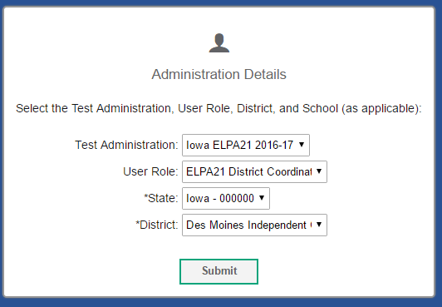
Select Your User Role and
Click Submit
Notes:
A quick reminder of our norms (Stay positive)

Slide 11
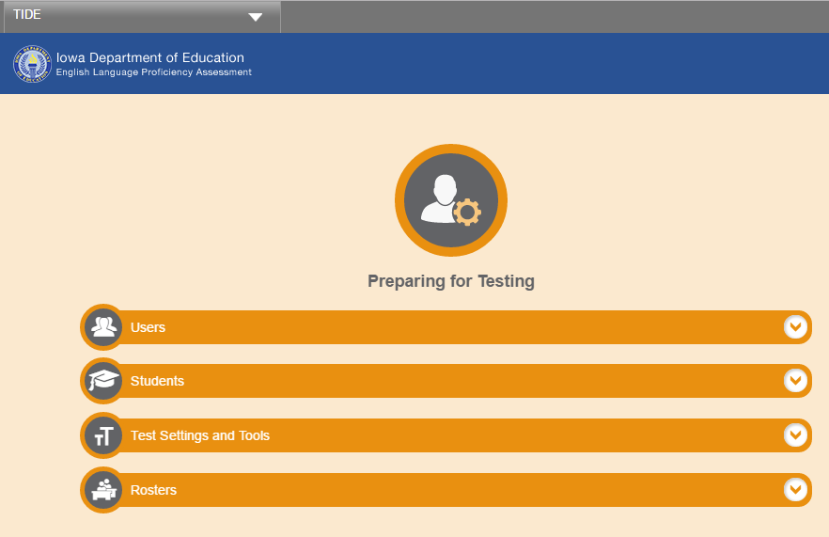
Click on Rosters
Notes:
A quick reminder of our norms (Stay positive)

Slide 12
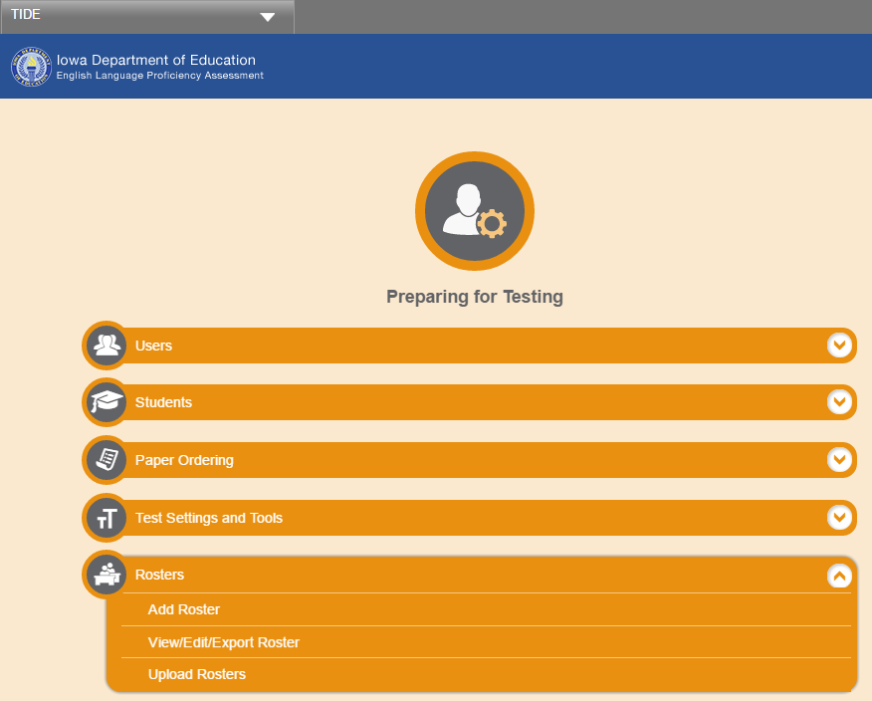
Click on View/Edit/Export
Notes:
A quick reminder of our norms (Stay positive)

Slide 13
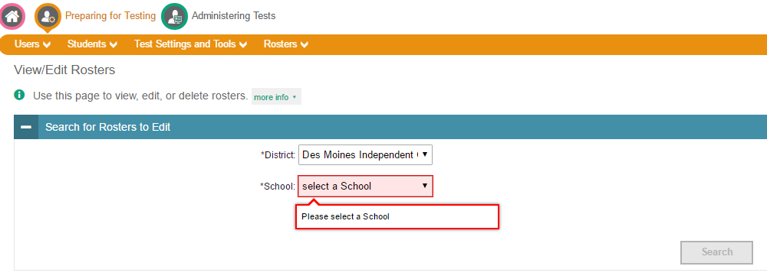
Select a School and Click Search
Notes:
A quick reminder of our norms (Stay positive)

Slide 14
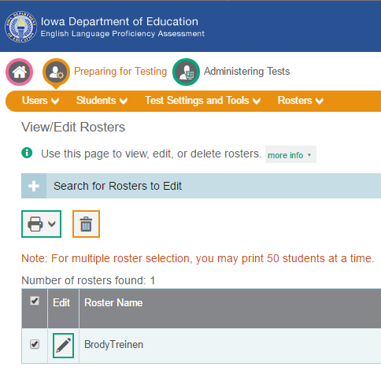
Check the Check Box Next to the Edit Column
Notes:
A quick reminder of our norms (Stay positive)

Slide 15
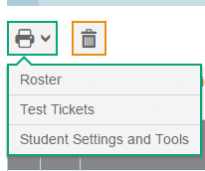
Click on the Printer Icon…
A drop down box will appear.
Select to print one of the choices in the box
Notes:
A quick reminder of our norms (Stay positive)

Slide 16
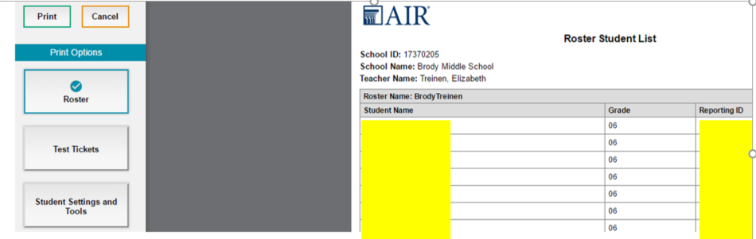
Click Print
Notes:
A quick reminder of our norms (Stay positive)

Slide 17
Add a New Roster

Slide 18
Click on Rosters
Notes:
A quick reminder of our norms (Stay positive)

Slide 19
Click on Add Roster
Notes:
A quick reminder of our norms (Stay positive)

Slide 20
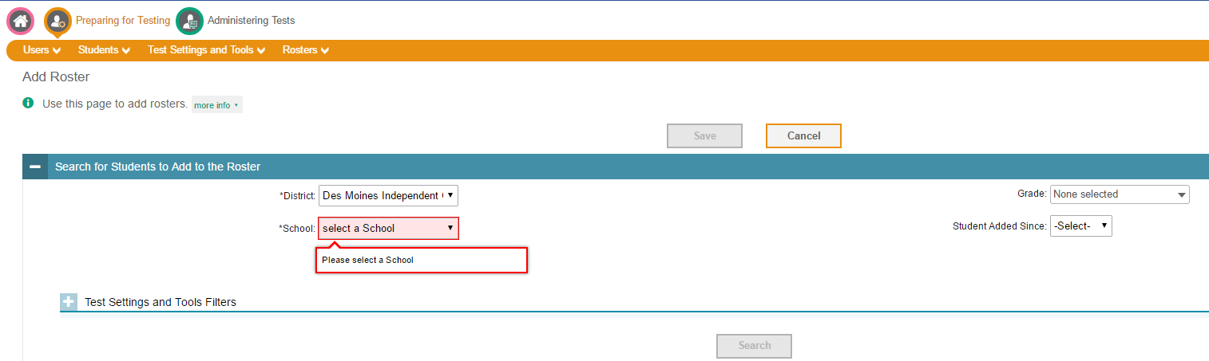
Select a School and Click Search
Notes:
A quick reminder of our norms (Stay positive)

Slide 21
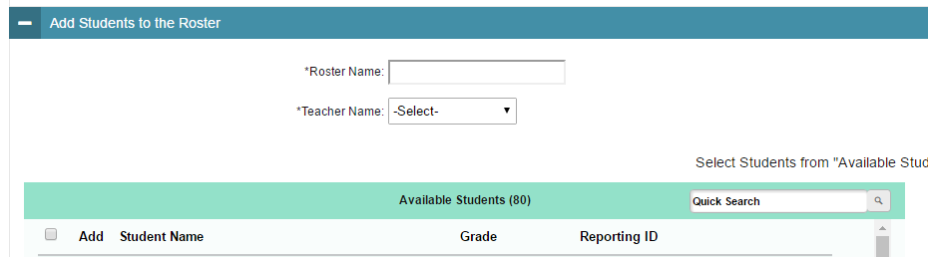
Type a Roster Name and Select a Teacher from the Teacher Name Dropdown Box
Notes:
A quick reminder of our norms (Stay positive)

Slide 22
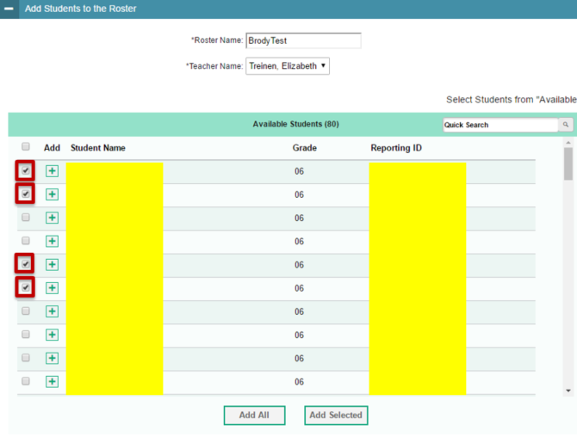
Select Students By Checking the Check Box by the Add Column
Notes:
A quick reminder of our norms (Stay positive)

Slide 23
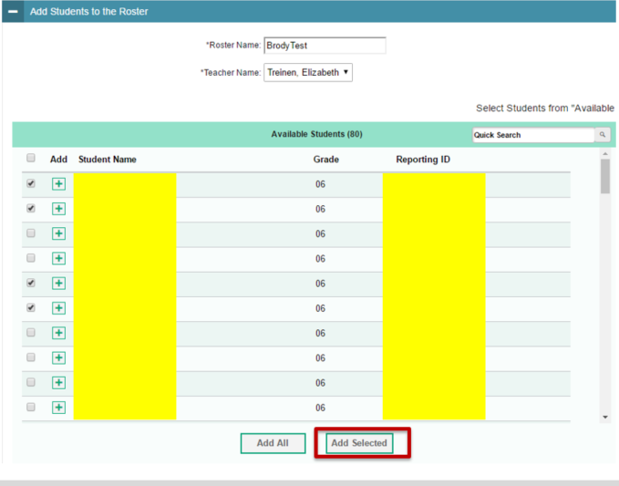
Click Add Selected
Notes:
A quick reminder of our norms (Stay positive)

Slide 24
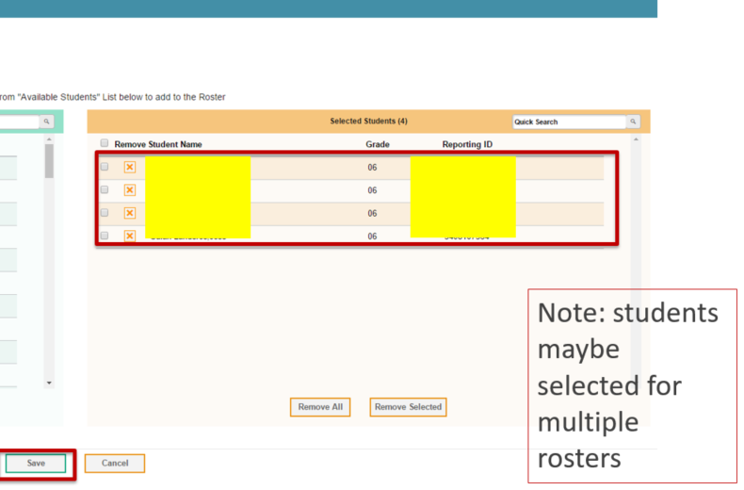
You Will See the Students Moved To the Selected Student Table-Click Save
Notes:
A quick reminder of our norms (Stay positive)

Slide 25
Adding and removing students from a Roster

Slide 26
Click on Rosters
Notes:
A quick reminder of our norms (Stay positive)

Slide 27
Click on View/Edit/Export
Notes:
A quick reminder of our norms (Stay positive)

Slide 28
Select a School and Click Search
Notes:
A quick reminder of our norms (Stay positive)

Slide 29
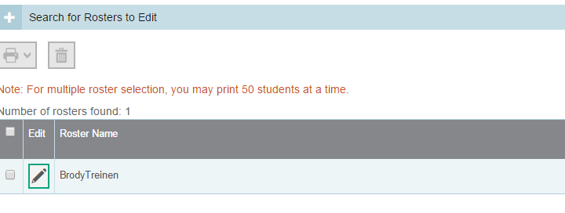
Click on the Pencil Icon Beside the Roster You Want to Add/Remove Students
Notes:
A quick reminder of our norms (Stay positive)

Slide 30
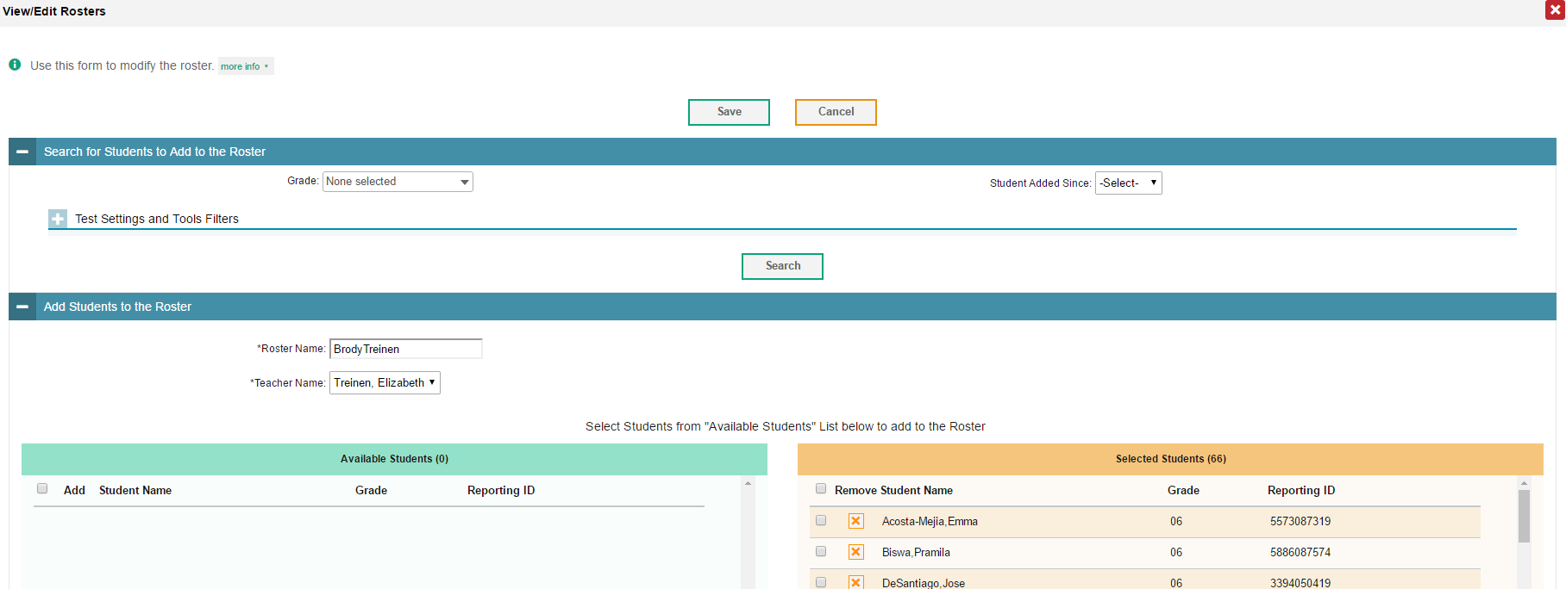
Click on the Search If You Want to Find Students to Add
Notes:
A quick reminder of our norms (Stay positive)

Slide 31
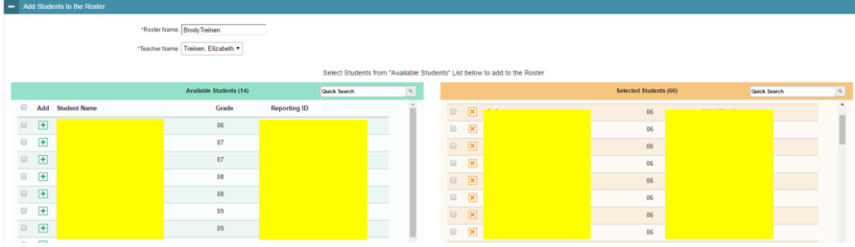
If You Clicked Search
You May Select Students to Add
Notes:
A quick reminder of our norms (Stay positive)

Slide 32
Try adding/removing a student to your roster

Slide 33
Check Testing Materials

Slide 34



1. Check Your Tech Materials
This icon (Secure Browser) is on every desktop of every computer that will be used for testing
Test your Headphones with Microphones to ensure they are working properly
Computers are fully charged or plugged in
Notes:
A quick reminder of our norms (Stay positive)

Slide 35
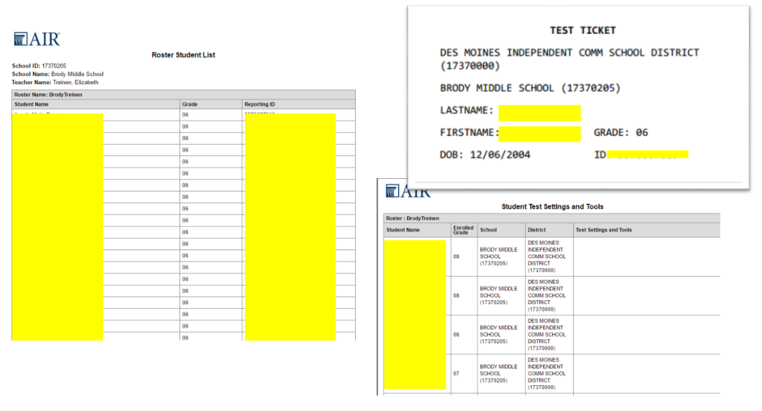
2. Verify All Student Are Loaded in TIDE (print your roster or test ticket or student settings and tools.
Notes:
A quick reminder of our norms (Stay positive)

Slide 36
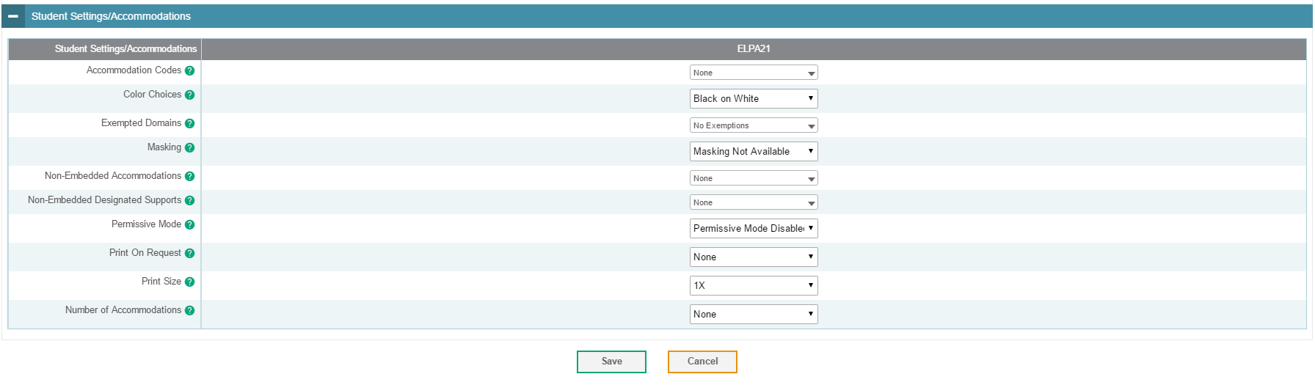
3. Assign Designated Support/Accommodation as Needed
For support refer to Critical ELPA21 Assessment Information booklet pp.16-19
and contact the Special Education Teacher
Notes:
A quick reminder of our norms (Stay positive)

Slide 37

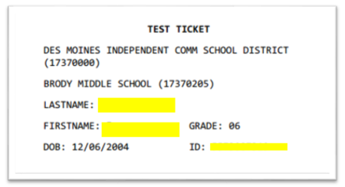
4. Print Test Tickets and Store Then Securely
Notes:
A quick reminder of our norms (Stay positive)

Slide 38
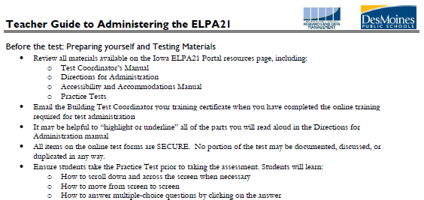


4. Ensure You Have All Materials You Need for Testing
Notes:
A quick reminder of our norms (Stay positive)

Slide 39
Entering Designated Supports/ Accommodations

Slide 40
Go To Students
Notes:
A quick reminder of our norms (Stay positive)

Slide 41
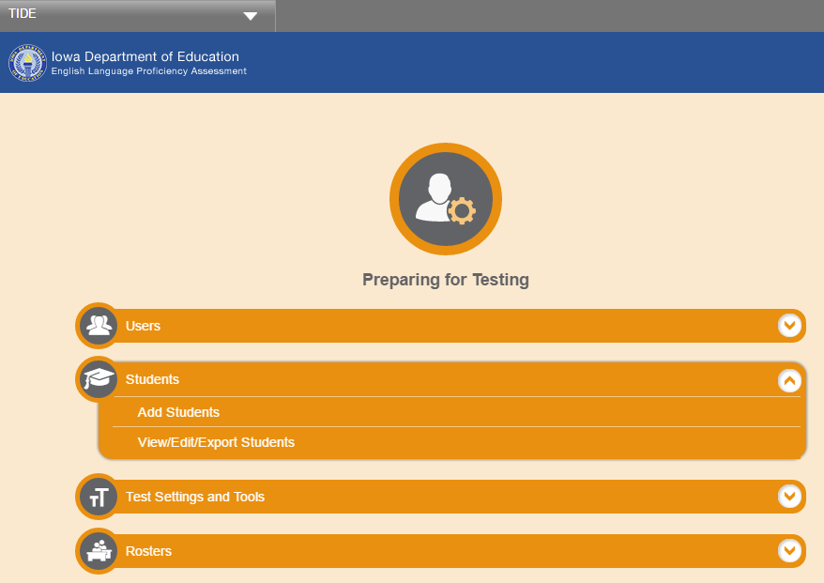
Click on View/Edit/Export Students
Notes:
A quick reminder of our norms (Stay positive)

Slide 42
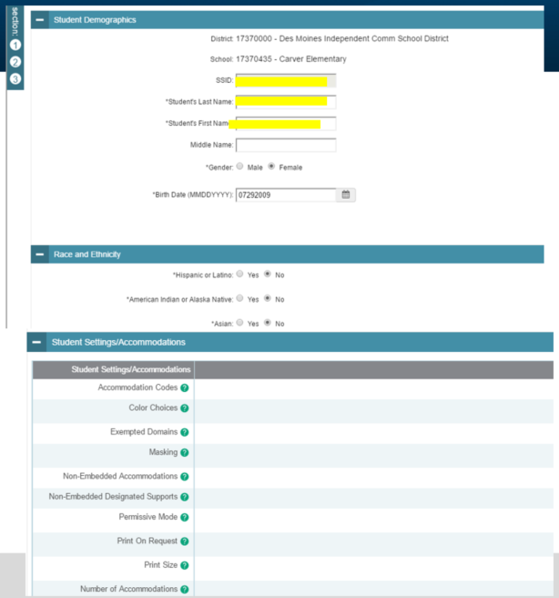
You Will See…
Notes:
A quick reminder of our norms (Stay positive)

Slide 43
Assign Designated Support/Accommodation as Needed
For support refer to Critical ELPA21 Assessment Information booklet pp.16-19
and contact the Special Education Teacher
Notes:
A quick reminder of our norms (Stay positive)

Slide 44
Printing Test Tickets

Slide 45
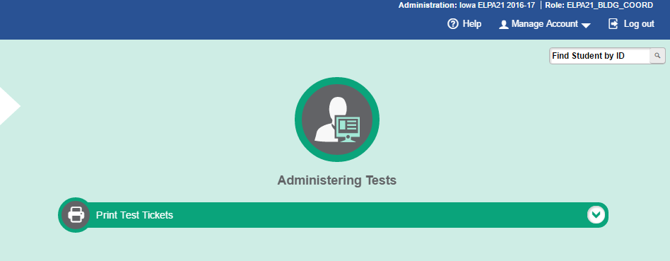
Click on Print Test Tickets
Notes:
A quick reminder of our norms (Stay positive)

Slide 46
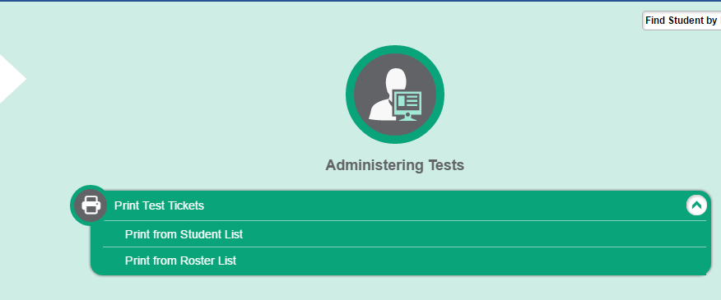
Click on Print from Roster List
Notes:
A quick reminder of our norms (Stay positive)

Slide 47
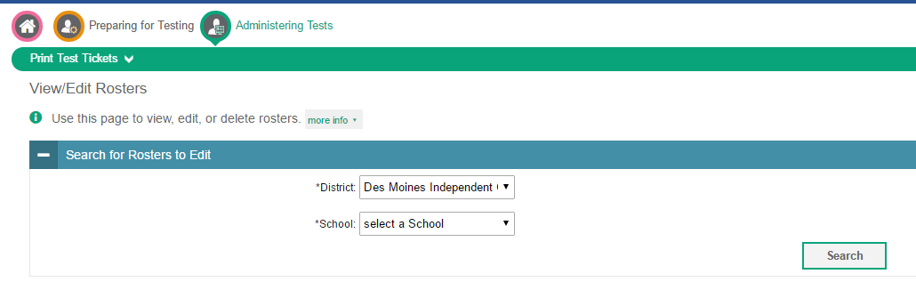
Select a School and Click Search
Notes:
A quick reminder of our norms (Stay positive)

Slide 48
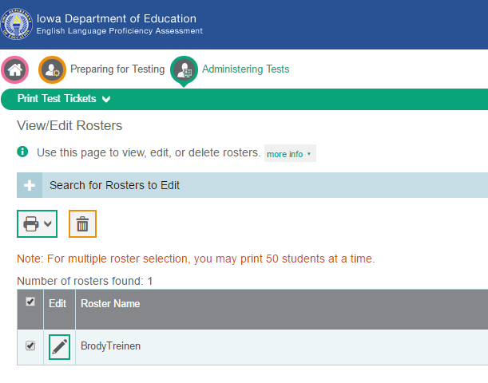
Check the Check Box Next to the Edit Column
Notes:
A quick reminder of our norms (Stay positive)

Slide 49
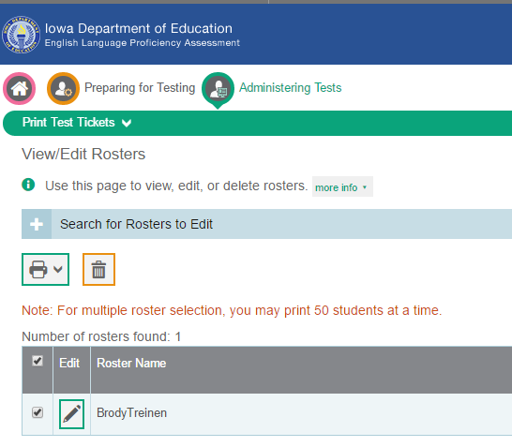
Click on the Printer Icon…
A drop down box will appear.
Select to Test Tickets
Notes:
A quick reminder of our norms (Stay positive)

Slide 50
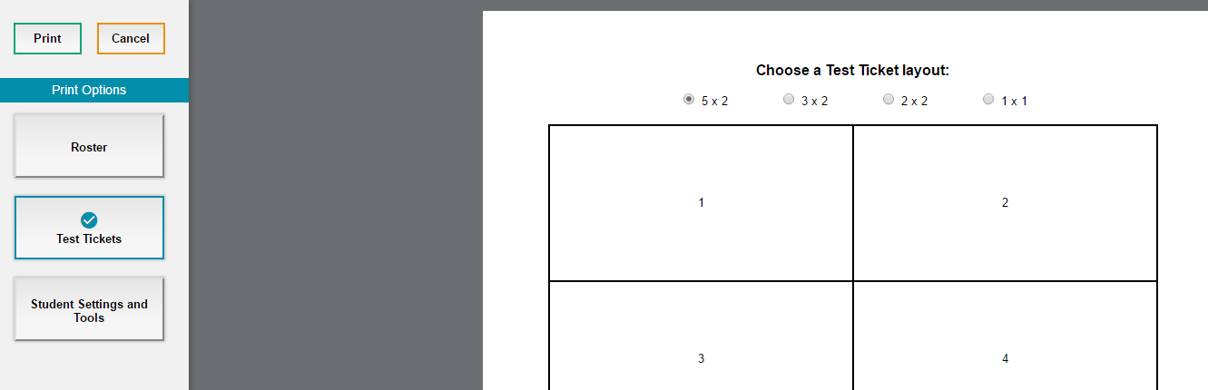
Choose a Ticket layout and
Click Print
Notes:
A quick reminder of our norms (Stay positive)

Slide 51
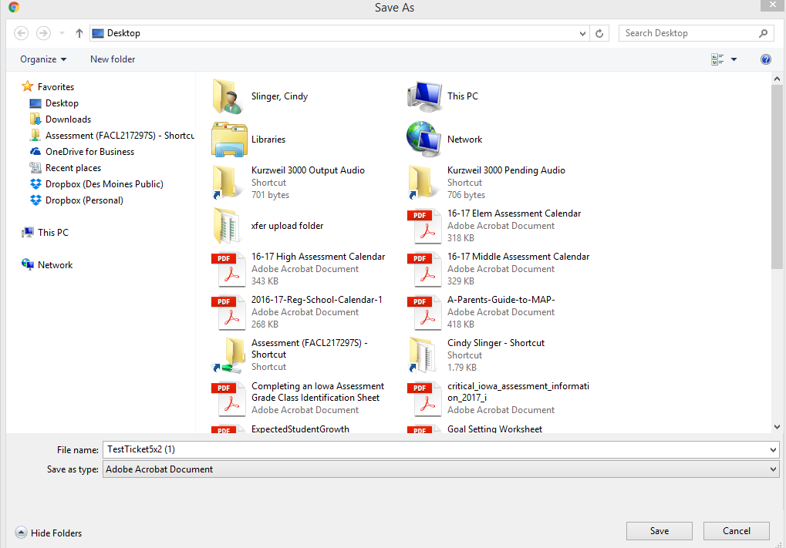
A Pop Up Box Will Appear
Notes:
A quick reminder of our norms (Stay positive)

Slide 52
Click on Desktop and Click Save
Notes:
A quick reminder of our norms (Stay positive)

Slide 53

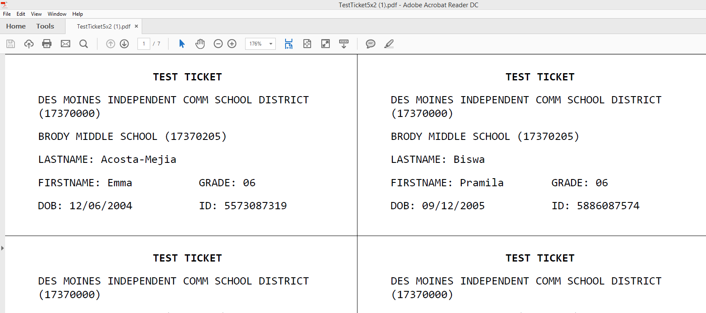
Look on Your Desktop
Double click on the icon and it will open
Click on the printer icon
Notes:
A quick reminder of our norms (Stay positive)

Slide 54
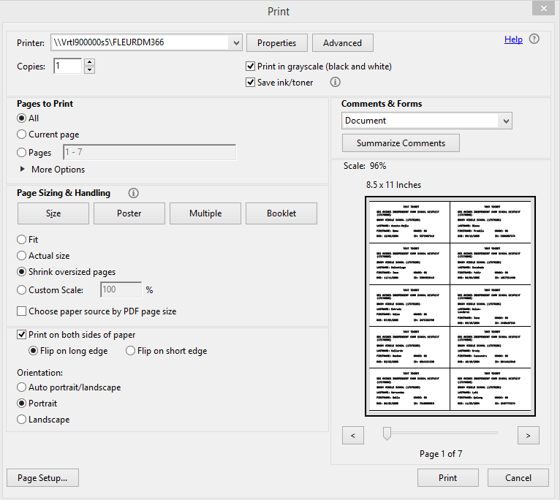
Pop Up Box
Click Print
Notes:
A quick reminder of our norms (Stay positive)

Slide 55
Testing
Test delivery System
(TDS)

Slide 56
Test Delivery System (TDS)
Student Interface- students use to navigate through the test (students must use the secure browser to take the operational test)
Test Administrator Interface- manage test sessions and monitor student progress

Slide 57
Steps in Administering the Online Test
1. The Test Administrator selects tests and starts a test session.
2. Students sign in and request approval for tests.
3. The TA reviews students’ requests and approves them for testing.
4. Students complete and submit their tests.
5. The TA stops the test session and logs out.
Notes:
A quick reminder of our norms (Stay positive)

Slide 58

Log into Iowa ELPA21
Notes:
A quick reminder of our norms (Stay positive)

Slide 59
Log into Iowa ELPA21
Notes:
A quick reminder of our norms (Stay positive)

Slide 60
When you log into the TA Interface-select tests
Create test sessions less than 20 minutes before administering tests or the session may time out.
Notes:
A quick reminder of our norms (Stay positive)

Slide 61
Start Test Session
Notes:
A quick reminder of our norms (Stay positive)

Slide 62

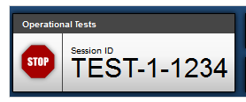
Write Down the Test Session ID
TEST – 1- 1234
For students to log into the test session
If the browser closes and you need to return to the test session
Notes:
A quick reminder of our norms (Stay positive)

Slide 63
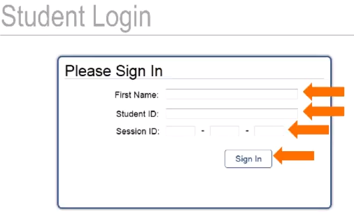
What Students See
If students have their test tickets, they won’t have to memorize their student ID.
Notes:
A quick reminder of our norms (Stay positive)

Slide 64
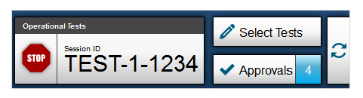
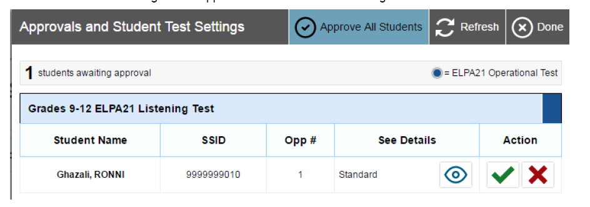
Approve Student for Testing
A window will appear.
Notes:
A quick reminder of our norms (Stay positive)

Slide 65
Check Student’s Test Settings
Student test settings may not be changed when a student is testing.
Notes:
A quick reminder of our norms (Stay positive)

Slide 66
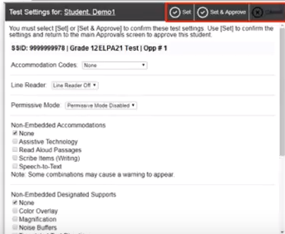
Update Settings if Needed
Notes:
A quick reminder of our norms (Stay positive)

Slide 67
Students Will Have…
Login Confirmation
An Audio Playback Check
A Microphone Check
Test Instructions and Help
Notes:
A quick reminder of our norms (Stay positive)

Slide 68
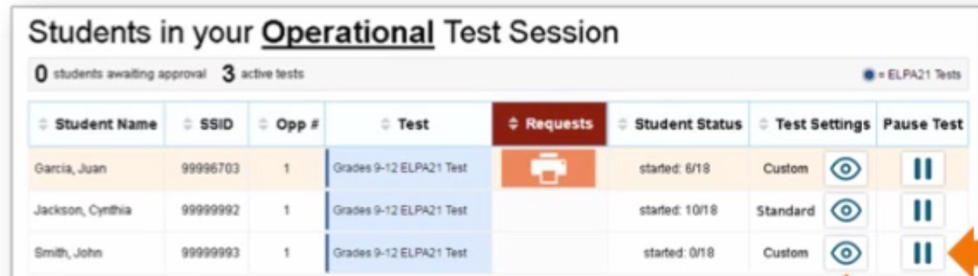
Monitor Student Progress
Notes:
A quick reminder of our norms (Stay positive)

Slide 69
Pausing a Student’s Test
Notes:
A quick reminder of our norms (Stay positive)

Slide 70
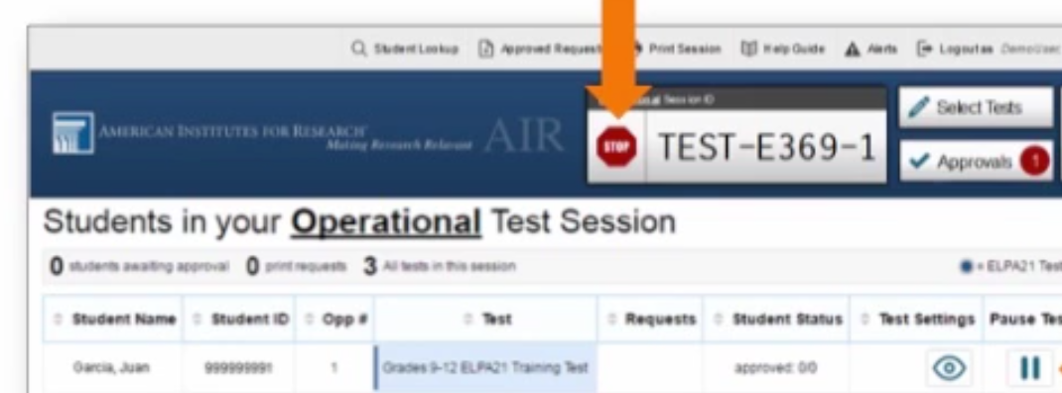
Stopping a Test Session
Once a test session has been stopped it can’t be resumed. You will need to create a new test session.
Notes:
A quick reminder of our norms (Stay positive)

Slide 71
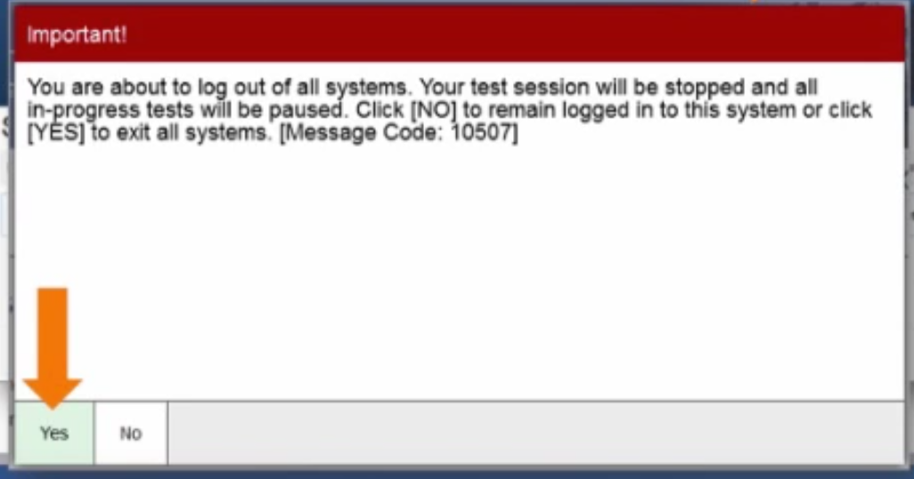
Stopping a Test Session
Notes:
A quick reminder of our norms (Stay positive)

Slide 72
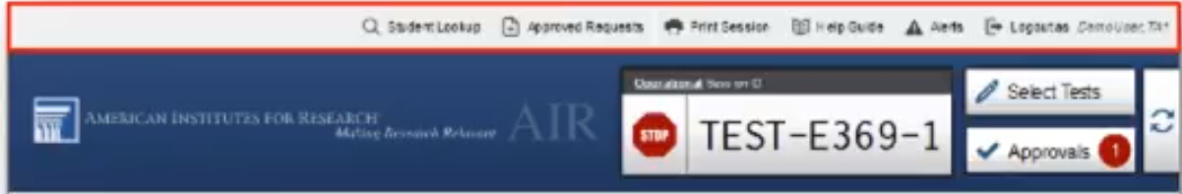
Banner at Top of Test Session
Student Look up: Look up student log in information
Notes:
A quick reminder of our norms (Stay positive)

Slide 73
Banner at Top of Test Session
Approve Requests: To see a list of what you have approved for this test session (print on request)
Notes:
A quick reminder of our norms (Stay positive)

Slide 74
Banner at Top of Test Session
Print Session: To print a screenshot of the Test Administrator Interface- you will have a list of students that didn’t complete testing
Notes:
A quick reminder of our norms (Stay positive)

Slide 75
Banner at Top of Test Session
Help Guide: To access additional information about the Test Administrator Interface
Notes:
A quick reminder of our norms (Stay positive)

Slide 76
Banner at Top of Test Session
Alerts: To view messages sent by the Iowa Department of Education
Notes:
A quick reminder of our norms (Stay positive)

Slide 77
Banner at Top of Test Session
Log Out: To exit the Test Administrator Interface
Notes:
A quick reminder of our norms (Stay positive)

Slide 78
Important Information
Associates and BCO Workers may NOT administer or proctor the ELPA21 test.
The ELPA21 Test Administrator training (available at http://training.aeapdonline.org) MUST be completed before teachers begin testing. Training certificates should be emailed to your Building Test Coordinator
Students with accommodations written into their IEP/504 Plan MUST receive these accommodations.
Notes:
A quick reminder of our norms (Stay positive)

Slide 79
ELL ?
ALL ELL students MUST take the ELPA21 if they are in our district at any time during the testing window-February 14- April 14 (unless they have already taken the ELPA21 test this year.)
New students that enroll after the testing window opens and have not been previously identified as ELL in another district will only need to take the TELPA

Slide 80
Q & A

